Slide 1
Title of Presentation
Bangladesh University of Engineering and Technology
Department of Electrical and Electronic Engineering
Masters Final Examination
Date: 1st December 2022
Presented by:
Mr. John Doe
MSc Candidate
Student ID: 042106XXXX
Examination Committee:
Dr. XYZ (Chairperson)
Dr. Head (Ex-Officio)
Dr. XY (Member)
Dr. XY (Member)
Dr. XY, Dept of XY, Uni (External Member)

Slide 2
Outline of Presentation
Summary
Acknowledgement and References
Literature Review
Simulation
Results
Design
Conclusion

Slide 3
Outline of Presentation
Summary
Acknowledgement and References
Literature Review
Simulation
Results
Design
Conclusion

Slide 4
Summary

Slide 5
Outline of Presentation
Summary
Acknowledgement and References
Literature Review
Simulation
Results
Design
Conclusion

Slide 6
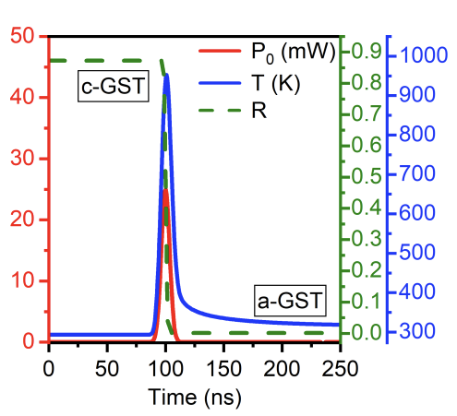
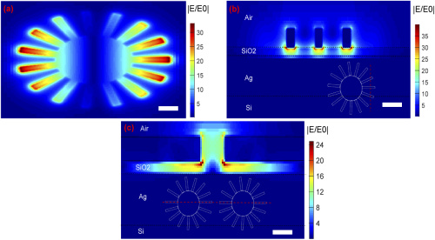
Literature Review
GST Modulator
Gear-shaped Resonator
AH Bhuiyan et al. Appl Optics (2022)
YF Abed et al. J. Opt. Soc. Am. B (2021)

Slide 7
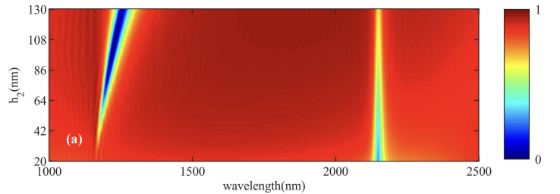
Literature Review
Nano Cavity Based Sensor
Structure
Reflection Spectra
Mode 1 occurs when h2 is greater than 30 nm and undergoes a small redshift with the increase of h2 while mode 2 does not undergo any significant spectral shift
YF Abed et al. J. Opt. Soc. Am. B (2021)

Slide 8
Outline of Presentation
Summary
Acknowledgement and References
Literature Review
Simulation
Results
Design
Conclusion

Slide 9
Design

Slide 10
Outline of Presentation
Summary
Acknowledgement and References
Literature Review
Simulation
Results
Design
Conclusion

Slide 11
Simulation

Slide 12
Outline of Presentation
Summary
Acknowledgement and References
Literature Review
Simulation
Results
Design
Conclusion

Slide 13
Results

Slide 14
Outline of Presentation
Summary
Acknowledgement and References
Literature Review
Simulation
Results
Design
Conclusion

Slide 15
Conclusion

Slide 16
Outline of Presentation
Summary
Acknowledgement and References
Literature Review
Simulation
Results
Design
Conclusion

Slide 17
Acknowledgement and References

